Slide 1
ENLIGHTENERS
Team Members:
Mane Satya Mohanth
A Shiva Madhav
U Srimanth Reddy
K Mounika

Slide 2
PROBLEM STATEMENT
Visually impaired people face much inconvenience when interacting with the surrounding environments, and the most common challenge is to find dropped or misplaced personal items
To develop a model that assists blind to identify objects around them

Slide 3
Solution
Computer vision technology and Artificial Intelligence can be used for blind assistance, such as navigation and object detection
Camera placed on the top of the helmet captures the frame, detects the objects, provides voice feedback of his/her demanded objects

Slide 4
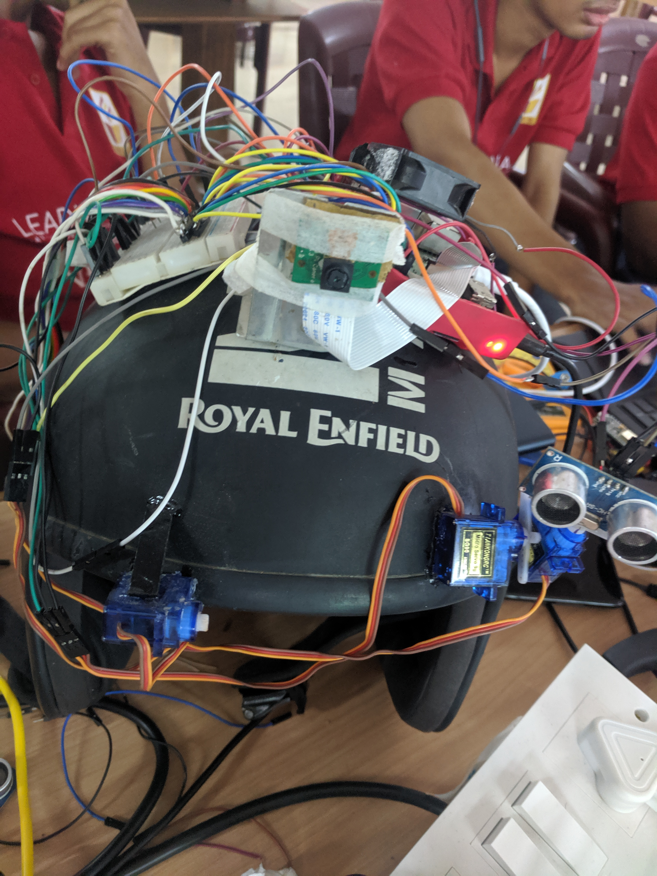
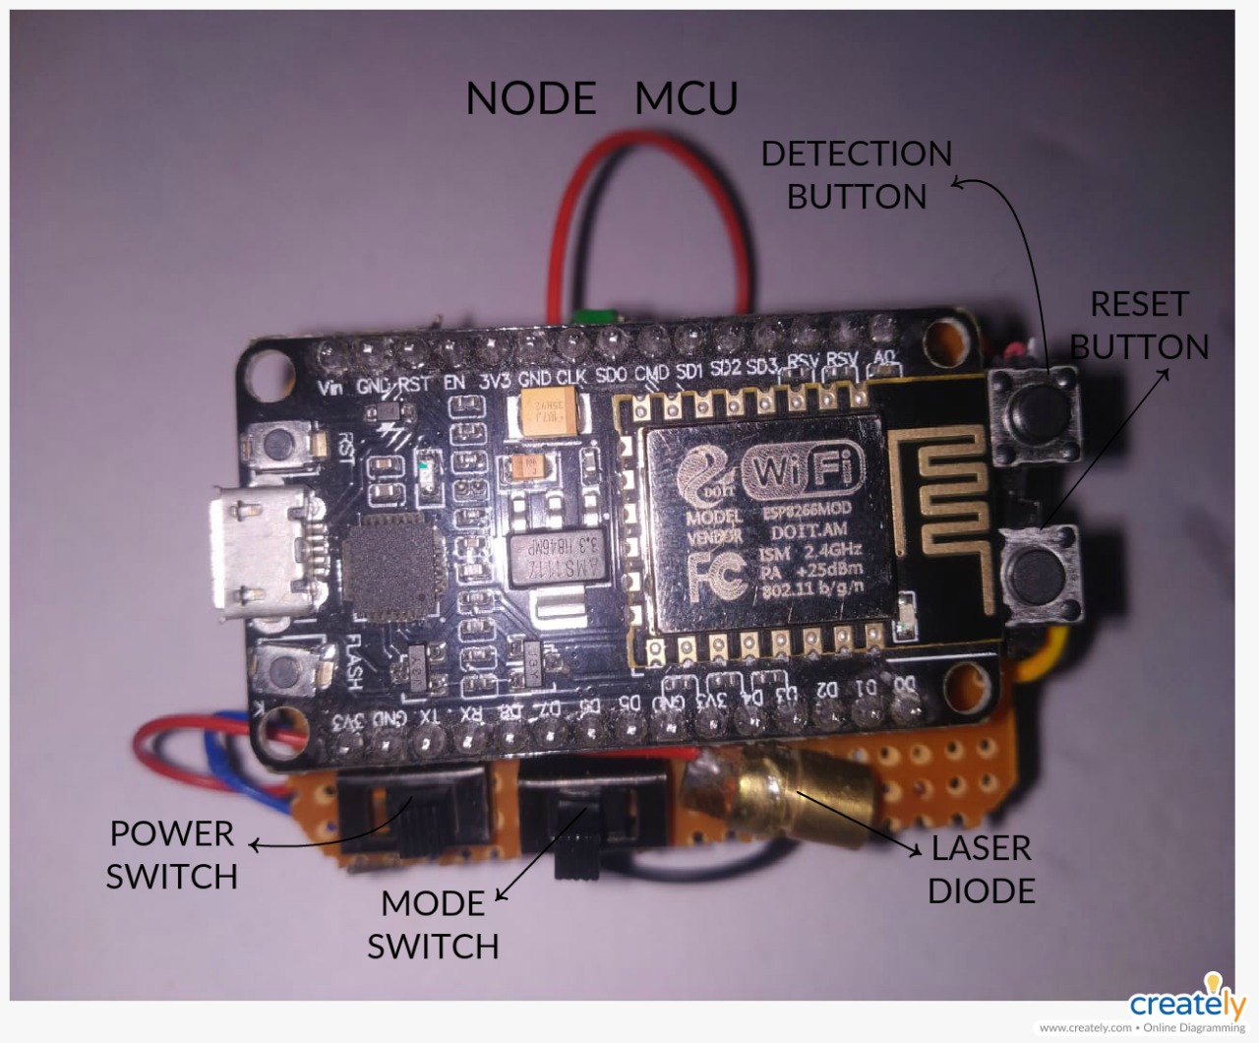
Pointer
Camera embedded

Slide 5
Limitations of above model
Continuous voice feedback could actually be uncomfortable and unnecessary some times
Also he might not be able to hear the surroundings

Slide 6
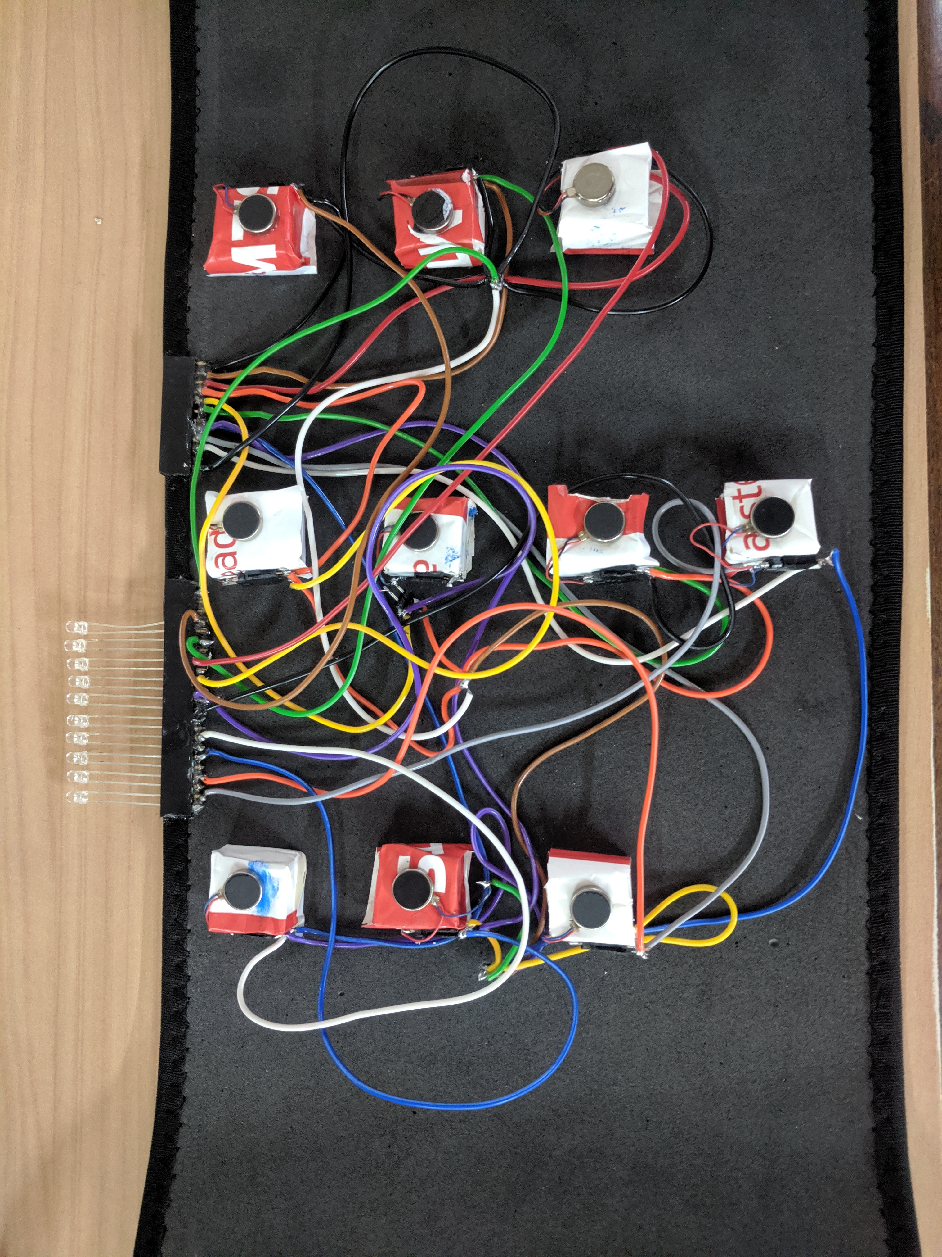
Overcoming the limitations
Our object detection model can classify up to 80 distinct classes
Each object is mapped to a unique binary code
Vibrators are activated in the vest according to the binary code

Slide 7
Conclusion and future work
Adding a GPS module for navigation purpose
Embedding a wide angle camera for better viewing angle
Better processor i.e, usage of micro processor.

Slide 8
Any suggestions /Queries?

Slide 9
Thank You 😇

